Slide 1
Race and Ethnicity Reporting for Clinical Trials in ClinicalTrials.gov and Publications
Kevin M. Fain, JD, MPH, DrPH¹
Julianne Nelson, PhD, MPH²
Tony Tse, PhD¹
Rebecca J. Williams, PharmD, MPH¹
ClinicalTrials.gov, National Center for Biotechnology Information, National Library of Medicine, National Institutes of Health
ICF
1

Slide 2
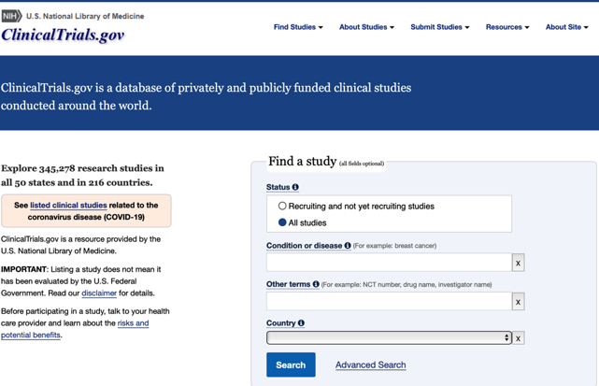
Disclaimer
Dr. Fain worked on this research while employed with the National Library of Medicine, NIH. He is currently employed with the Center for Drug Evaluation and Research, U.S. Food and Drug Administration (FDA).
The views expressed in this presentation are those of Dr. Fain and do not necessarily represent the views or policies of NIH or the Department of Health and Human Services (HHS), and should not be construed to represent FDA’s views or policies.
2

Slide 3
Background
Inclusion and reporting of minority clinical trial participants critical for understanding application of trial results to diverse populations
Recent studies suggest gaps in minority representation and reporting in clinical trials remain despite efforts to increase both¹⁻²
Federal regulations and NIH Policy* require reporting of any collected aggregate participant race/ethnicity information with study results to ClinicalTrials.gov³⁻⁵
Effective beginning on January 18, 2017
Regulation’s compliance date on April 18, 2017
*42 CFR Part 11 and NIH Policy on the Dissemination of NIH-Funded Clinical Trial Information
3

Slide 4
Background (continued)
Race/ethnicity information for trials with primary completion date (PCD) on or after January 18, 2017
“PCD” defined as date the final participant was examined or received intervention for final data collection for primary outcome
Beginning April 18, 2017
Options to report race/ethnicity
Standard NIH/OMB classifications
Sponsor-customized categories
Available at https://prsinfo.clinicaltrials.gov/results_definitions.html
4

Slide 5
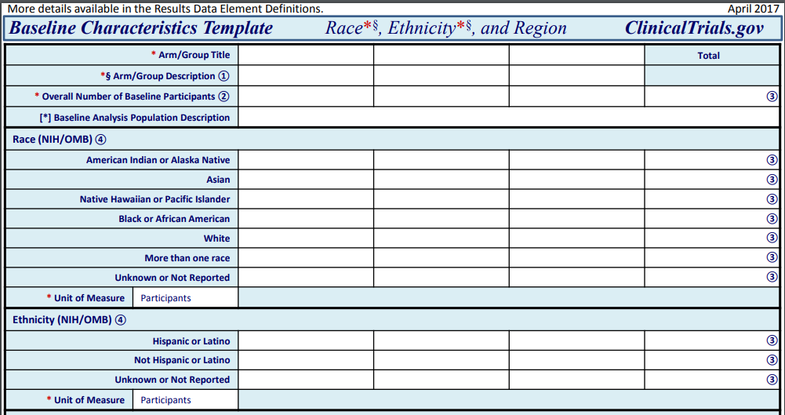
5

Slide 6
Example: Race/Ethnicity Customized
6
Notes:
https://clinicaltrials.gov/ct2/show/results/NCT04106817

Slide 7
Methods
Posted results with ≥1 US site on 12/2/19
Post-requirement Sample
Pre-requirement Sample
PCD ≥ 1/18/17 & Results First Submitted ≥ 4/18/17
3,542 Records
PCD < 1/18/17 & Results First Submitted 1/1/16 to 4/17/17
3,540 Records
Assessed reporting of race/ethnicity information in baseline characteristics

Slide 8
Methods: Additional Sampling for Analysis
“Post-Requirement” Sample
3542 Records
10% Random Sample
Trials with “Customized Reporting” of Race/Ethnicity
354 Records
741 Records
Trials with corresponding results publications in PubMed⁶
10% Random Sample
“Publication” Sample
117 Records
“Customized Reporting” Sample
74 Records

Slide 9
Findings: Race/Ethnicity Reporting Overall
Category of Reporting | Pre-requirement sample (N=3,540 studies) | Post-requirement sample (N=3,542 studies)
Race/ethnicity Reported | 42% (n=1,488) | 91% (n=3,239)
Race/ethnicity Indicated Not Collected | 1% (n=46) | 9% (n=303)
Race/ethnicity Not Reported | 57% (n=2,006) | 0%
9

Slide 10
Findings: Availability of Race/Ethnicity Information in Publications
Subset Analyzed for Publications (n=354)
67% of ClinicalTrials.gov posted results did not have corresponding publications (n=237)
33% of ClinicalTrials.gov posted results were also published (n=117)
38% of the publications did not report race/ethnicity information (n=44/117)
62% of the publications reported race/ethnicity information (n= 73/117)
Only 21% of ClinicalTrials.gov posted results had corresponding publications that reported race/ethnicity information (n=73/354)

Slide 11
Findings: Race/Ethnicity Reporting Standards
Pre-requirement sample (n=3,540)
Post-requirement sample (n=3,542)
42% of studies had race/ethnicity information reported (n=1,488)
68% used standard categories (NIH/OMB)
27% used customized categories
4% used both standard (NIH/OMB) and customized categories
91% of studies had race/ethnicity information reported (n=3,239)
70% used standard categories (NIH/OMB)
23% used customized categories
7% used both standard (NIH/OMB) and customized categories
Background is frequency of use by size of 74 reported customized categories

Slide 12
Conclusion
Disclosure of race/ethnicity increased; ClinicalTrials.gov complements publications
<10% post-requirement studies indicated race/ethnicity not collected
Standard NIH/OMB categories used frequently across both samples
Facilitates understanding and comparisons of race/ethnicity across trials and other resources
Use of customized categories makes such comparisons challenging
Use of “NIH/OMB classification” labels may not mean collection using NIH/OMB standard
Limitation: Did not assess representation of racial and ethnic groups in trials
ClinicalTrials.gov supports research of race/ethnicity and social determinants of health

Slide 13
References
[1] Hooper MW, Nápoles AM, & Pérez-Stable EJ. COVID-19 and Racial/Ethnic Disparities. JAMA. May 11, 2020.
[2] National Institutes of Health. NIH policy and guidelines on the inclusion of women and minorities as subjects in clinical research. 2017. Available at https://grants.nih.gov/policy/inclusion/women-and-minorities/guidelines.htm (accessed on November 15, 2019)
[3] NIH Policy on the Dissemination of NIH-Funded Clinical Trial Information. 2017. Available at https://www.federalregister.gov/documents/2016/09/21/2016-22379/nih-policy-on-the-dissemination-of-nih-funded-clinical-trial-information (accessed on November 15, 2019)
[4] National Institutes of Health, Department of Health and Human Services. Clinical trials registration and results information submission: final rule. Fed Regist 2016; 81: 64981-5157.
[5] Zarin DA, Tse T, Williams RJ, Carr S. Trial reporting in ClinicalTrials.gov - the final rule. N Engl J Med. 2016 Nov 17;375(20):1998-2004
[6] Ross et al. Publication of NIH funded trials registered in ClinicalTrials.gov: cross sectional analysis. BMJ. 2012; 344:d7292.

Slide 14
Appendix

Slide 15
Sampling: “Post-Requirement” Sample
PCD ≥ 1/18/2017
Results Submitted ≥ 4/18/2017
l
l
1/18/2017
4/18/2017
12/2/2019
Regulation Effective Date
Regulation Compliance Date
Downloaded Records

Slide 16
Sampling: “Pre-Requirement” Sample
PCD < 1/18/2017
Results Submitted
≥ 6/1/2016 and ≤ 4/17/2017
l
l
l
6/1/2016
1/18/2017
4/18/2017
12/2/2019
Regulation Effective Date
Regulation Compliance Date
Downloaded Records

Slide 17
Findings: Race/Ethnicity Reporting Overall

